Slide 1
Demand Forecast:Clustering Results
Soheil Latifi

Slide 2
Agenda
Objectives.
Datasets overview
Clustering workflow
Clustering features.
Clusters explained
Next steps.

Slide 3
Objectives
Building Game Attribute features used for similarity.
Developing a clustering pipeline make cohorts of game families
The cohorts should be similar in :
Theme
Math type
Core or premium
Finding the similar games for each holdout game ( recent games)
The similar game should have enough history for conducting the prediction.
Forecasting the recent game performance and sales using historical data.

Slide 4
Datasets overview
Eilers Performance Data:
Performance data collected for theme/cabinet combos
Core/Premium flag
Game release date flag
Game type flag
Attribute data:
Product family: cabinet related information
Math model family: Bingo lottery etc.
Game type
RTP: missing
Volatility: missing.
Number of lines: missing.
Max and min bet: missing.
Own status: missing.
The join between these 2 is necessary, 1373 of 3,146 unique games in attribute data can be joined with Eilers performance data after cleaning.
138 games were kept for holdout.
Important features such as RTP, Volatility max-bet etc. are missing.

Slide 5
Clustering workflow
Game names were cleaned from typos etc.
Niche theme types were unified for broader categories. (82->10)
130 games were set aside for clustering inference. (released in 2025-2026)
Features are weighted as requested.
Using elbow method, the games were clustered
The similarity method is Cosine metric (categorical features are dominant)
Using Agglomerative clustering with full linkage as instructed.

Slide 6
Clustering Features overview:
Feature Category | Source Field | Type | Feature Count | Base Weight
Game matrix / mechanics | game_matrix | Categorical | 15 | 1
Multi-game flag | is_multi_game | Boolean | 1 | 2.60
WAP flag | is_wap | Boolean | 1 | 2.20
Multi-denom flag | is_multi_denom | Boolean | 1 | 1.90
Poker flag | is_poker | Boolean | 1 | 1.90
Product segment | product_segment | Categorical | 9 | 1.80
Game class | game_classification | Categorical | 5 | 1.50
Theme category | semantic_theme_bucket | Categorical | 10 | 1.40
Own status | parent_own_status | Categorical | 3 | 1.30
Product family | product_family | Categorical | 4 | 1.00
Release age bucket | release_age_bucket | Categorical | 6 | 0.30

Slide 7
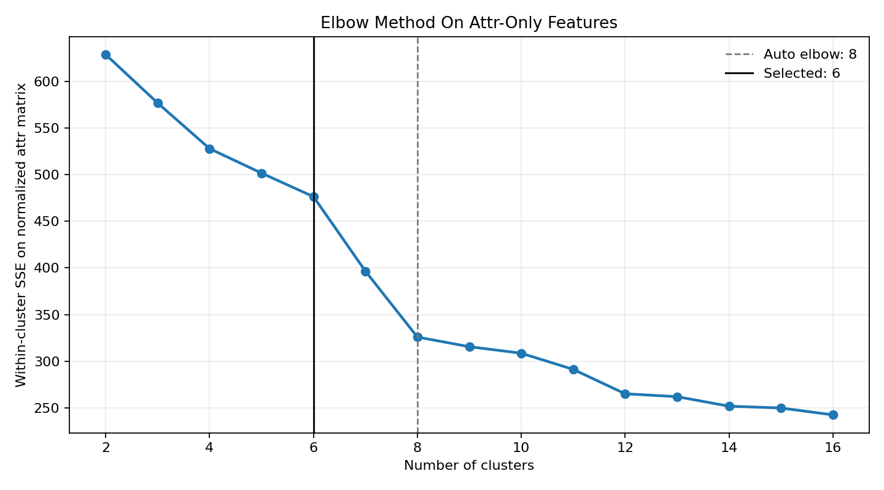
Clustering results

Slide 8
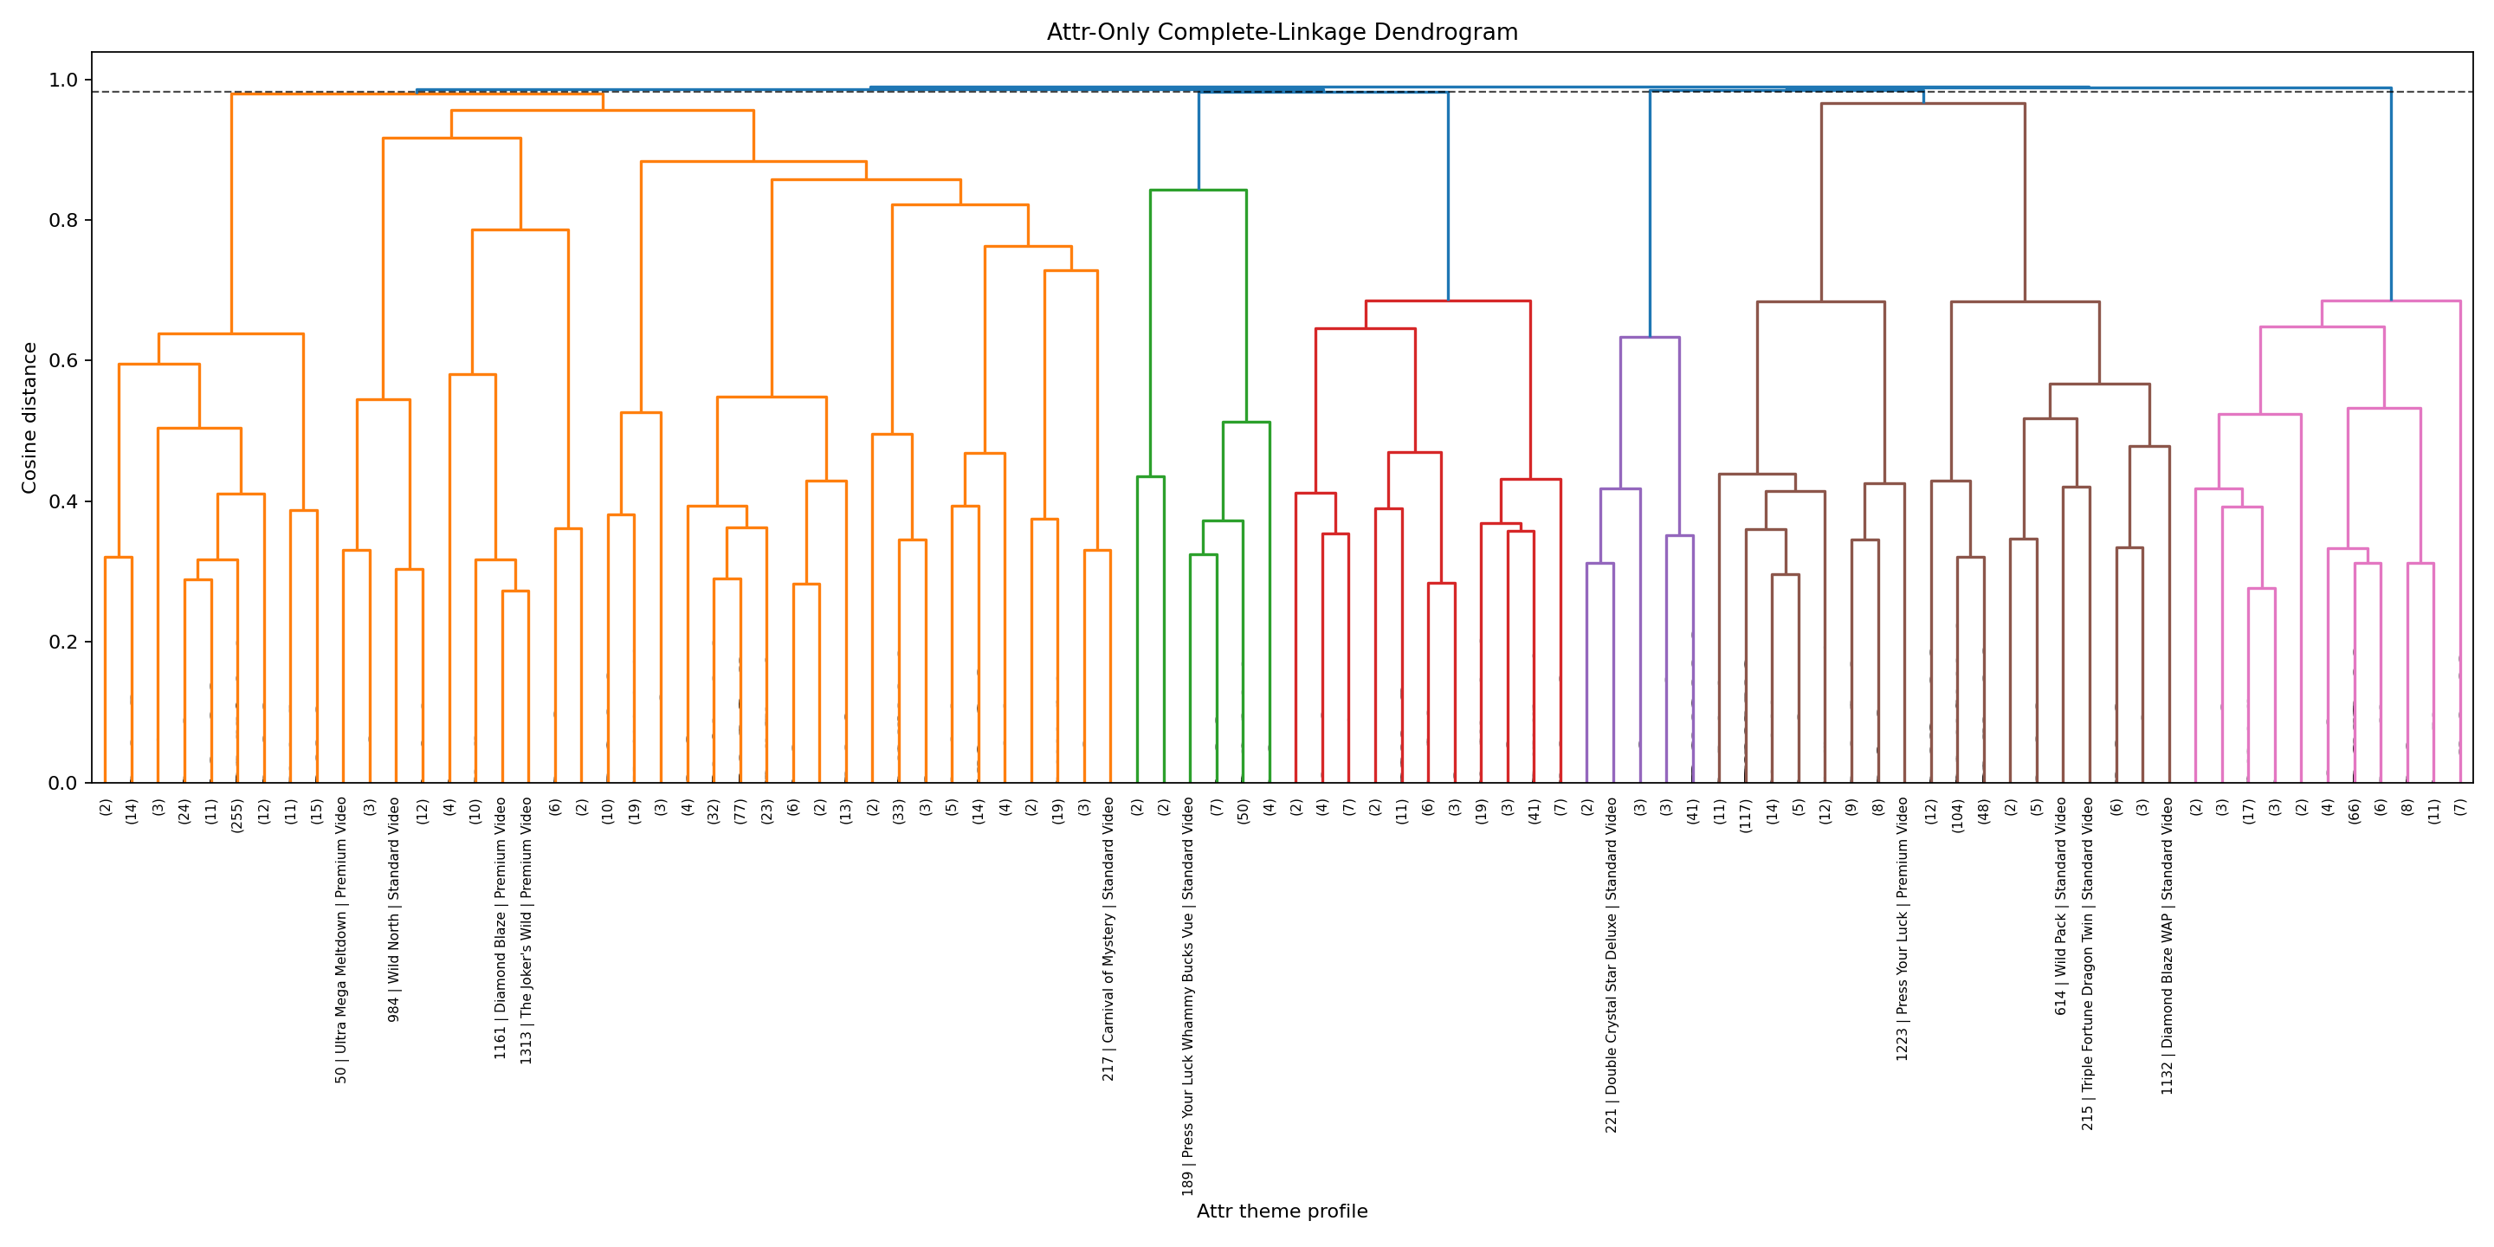
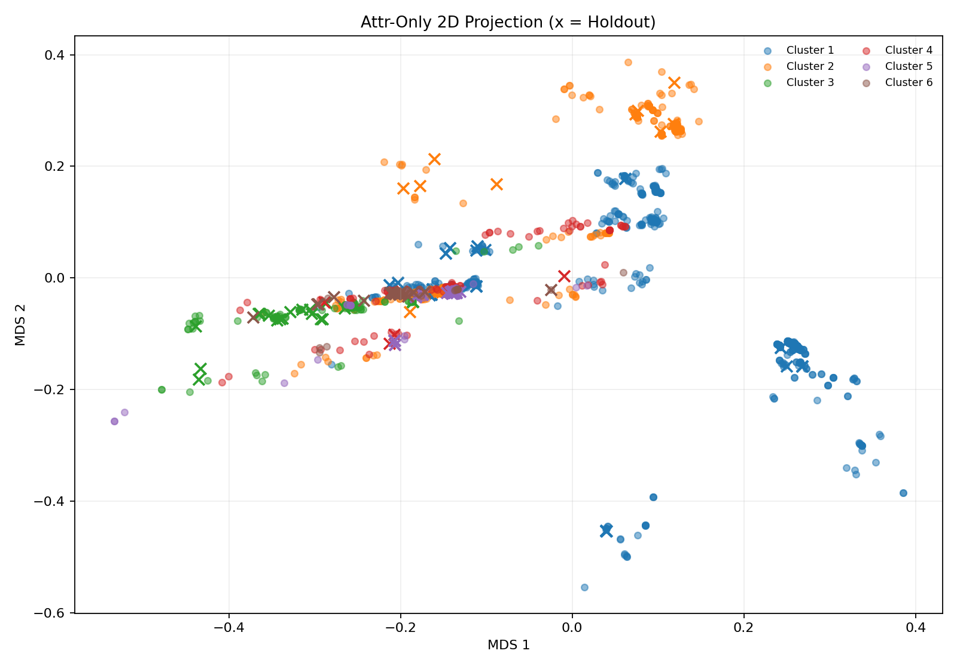
Dendrogram of the resulting clusters

Slide 9
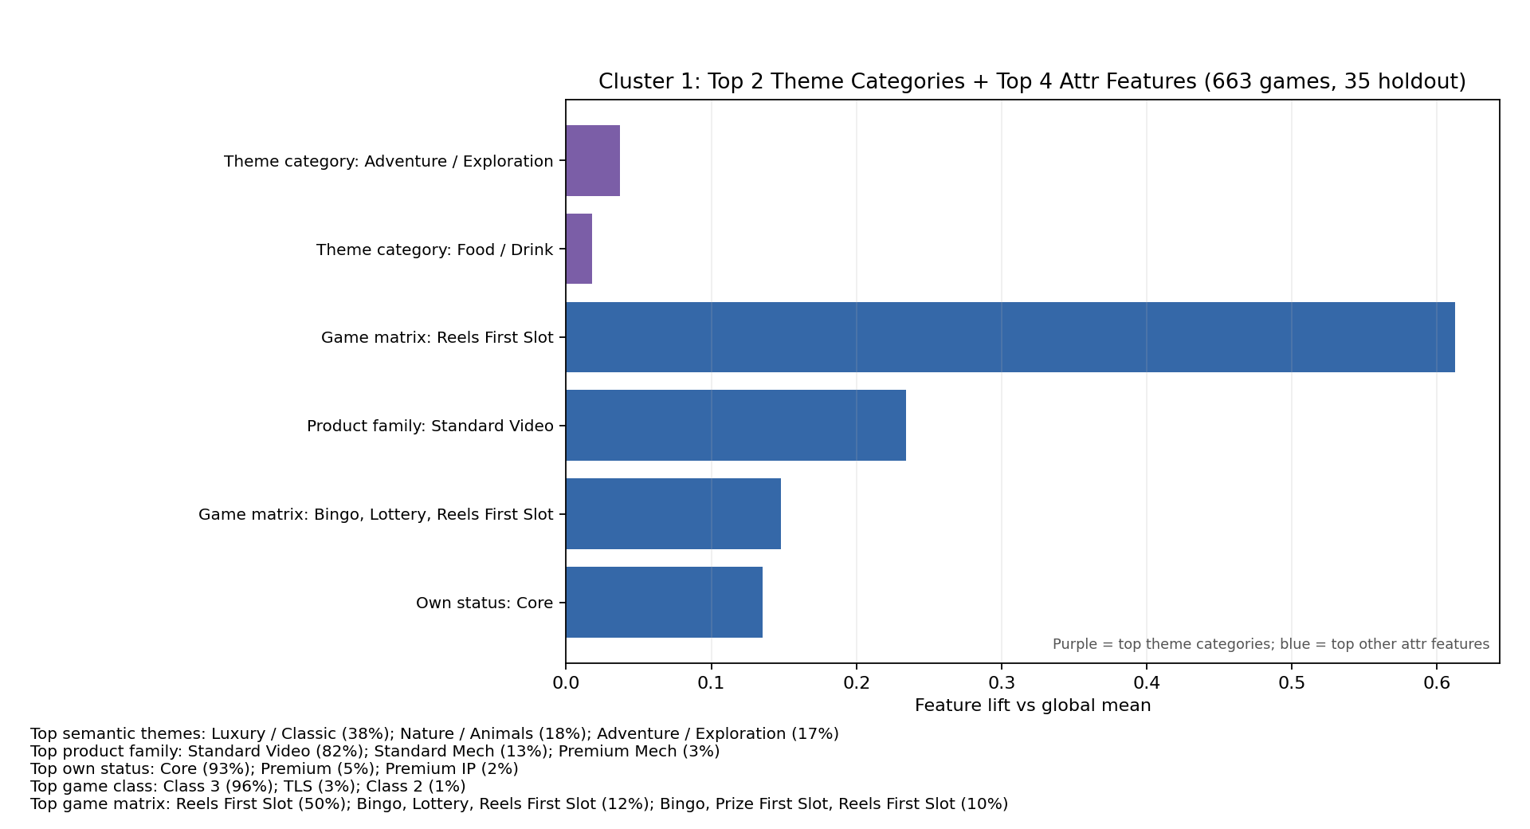
Cluster 1:
Historical examples: 7 Spins; 7 Spins HD; Aeronauts; Alakazam; Antony & Cleopatra; Arriba; Bank Heist; Beerfest; Best In Show; Big Hit Cash Holdout example: 888 Drums Eternity

Slide 10
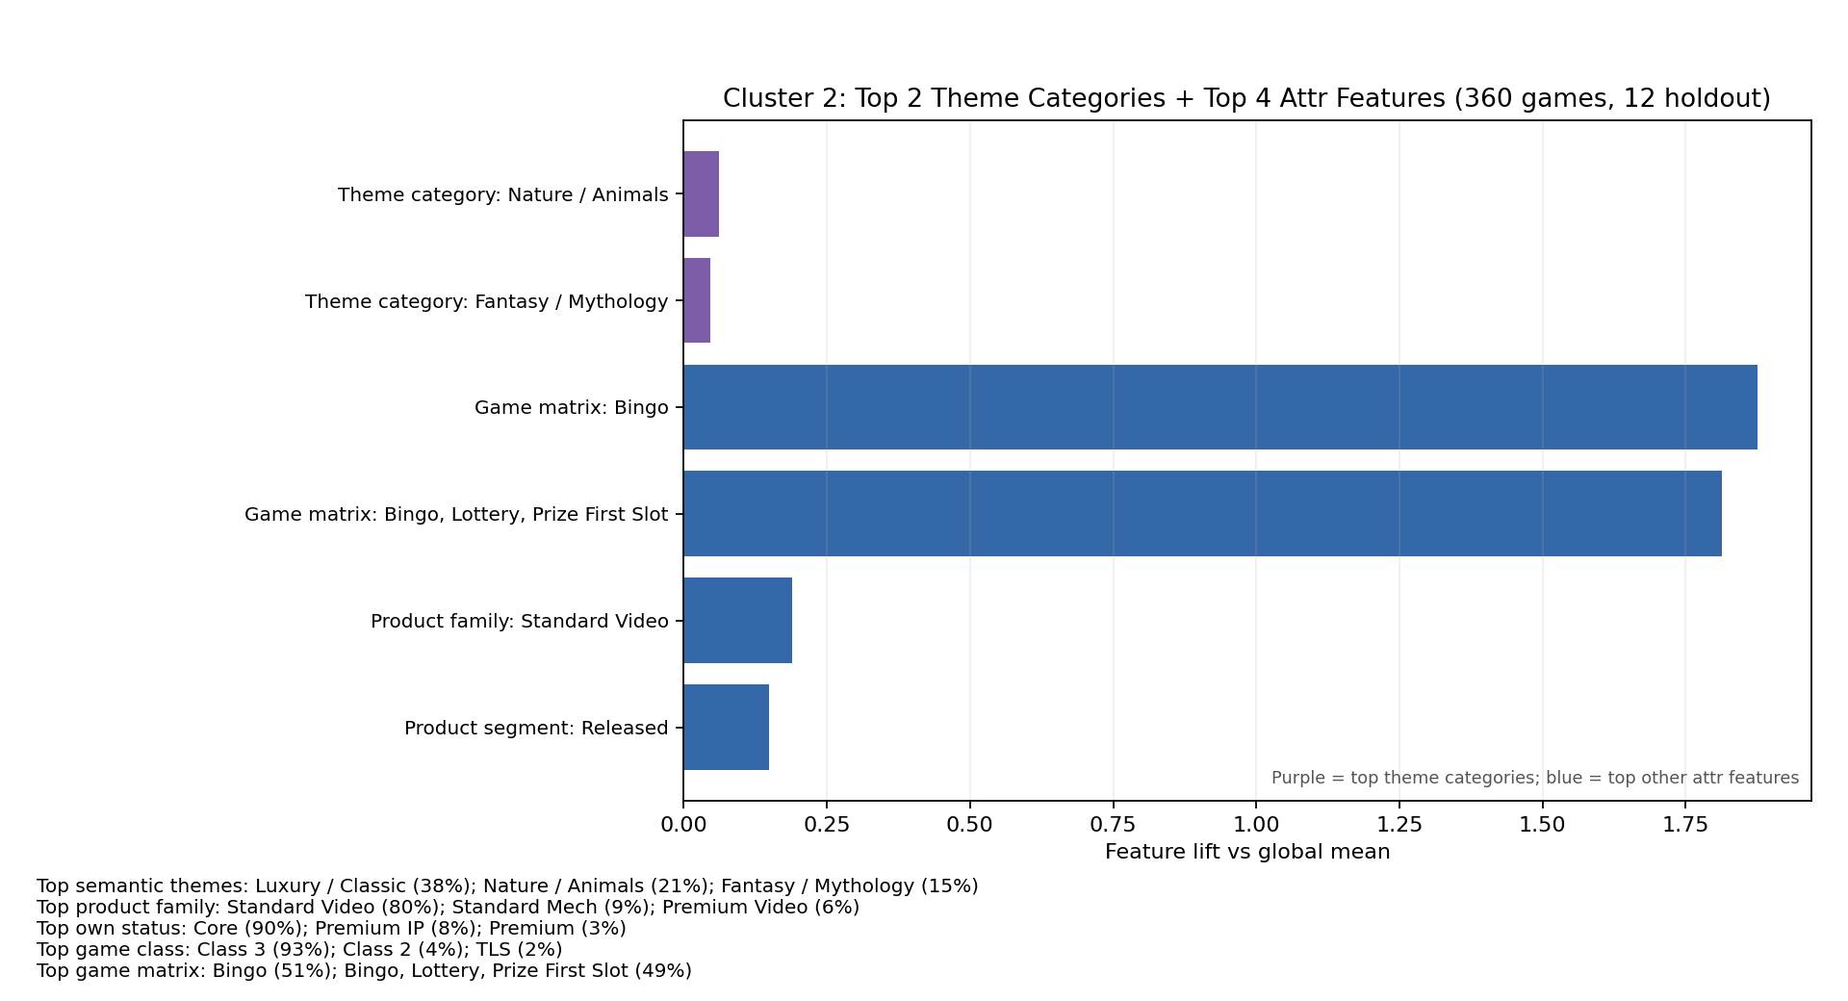
Cluster 2:
Historical examples: 7 Spins 50; 9 Diamonds; Aztec Banner; Bai Shou Feng Xiang; Bao Gong; Black Diamond; Blazin' Ice; Blazin' Jewels; Blazin' Triples; Bonnie and Clyde Holdout example: Astro Oink!

Slide 11
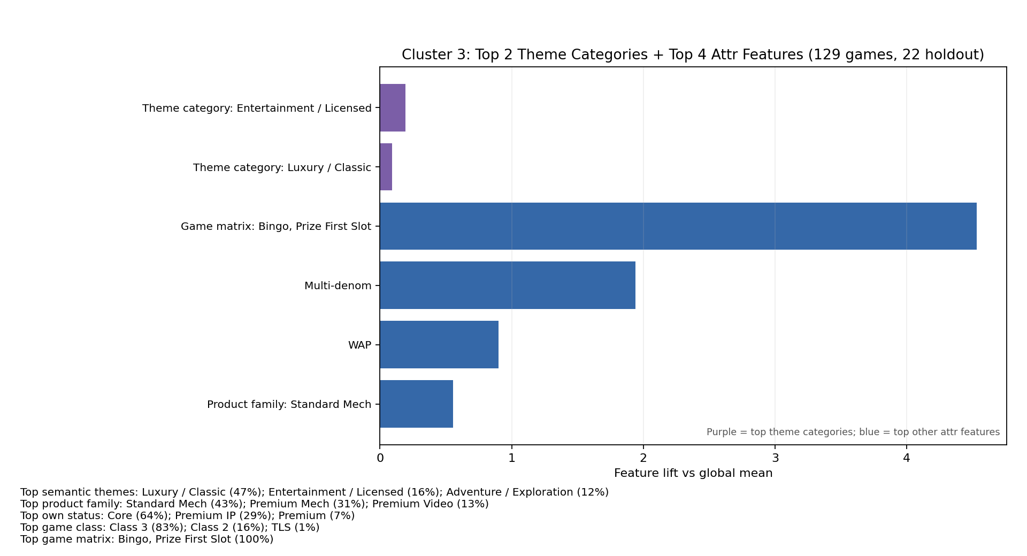
Cluster 3:
Historical examples: Atomic Meltdown; Aztec Treasure; Black Diamond Deluxe; Black Diamond Platinum; Black Diamond Platinum (9L90C); Black Diamond Platinum (9L9C); Black Diamond SAP; Blazin Gems; Blazin' Ice 45C; Buffy The Vampire Slayer Holdout example: 888 Drums Eternity Vue

Slide 12
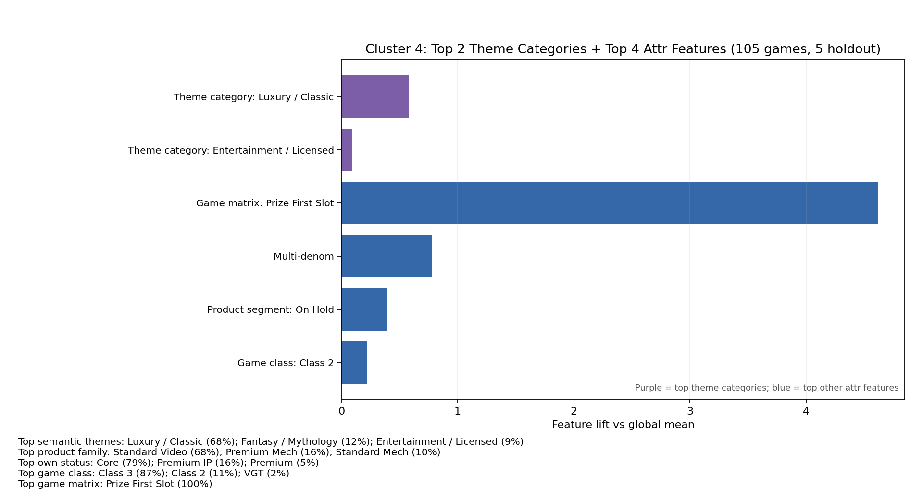
Cluster 4:
Historical examples: Black Diamond - OSL; Black Diamond IL; Black Diamond Platinum 9L90C; Black Diamond Platinum 9L9C; Blazin' Ice NV; Carnival In Rio - OSL; Carnival In Rio IL; Casablanca; Casablanca F1; Cash Machine - OSL Holdout example: Cash Machine Lock

Slide 13
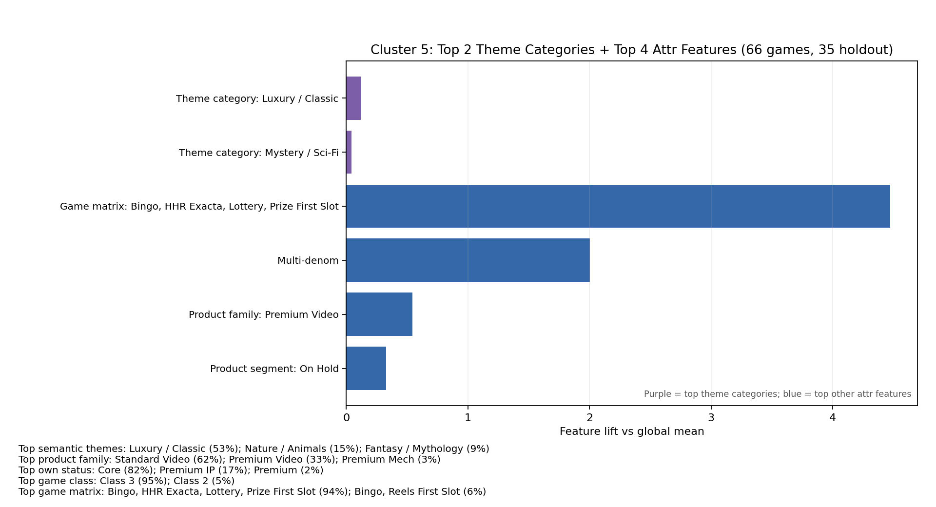
Cluster 5:
Historical examples: 7 Spins 50; 9 Diamonds; Aztec Banner; Bai Shou Feng Xiang; Bao Gong; Black Diamond; Blazin' Ice; Blazin' Jewels; Blazin' Triples; Bonnie and Clyde Holdout example: Astro Oink!

Slide 14
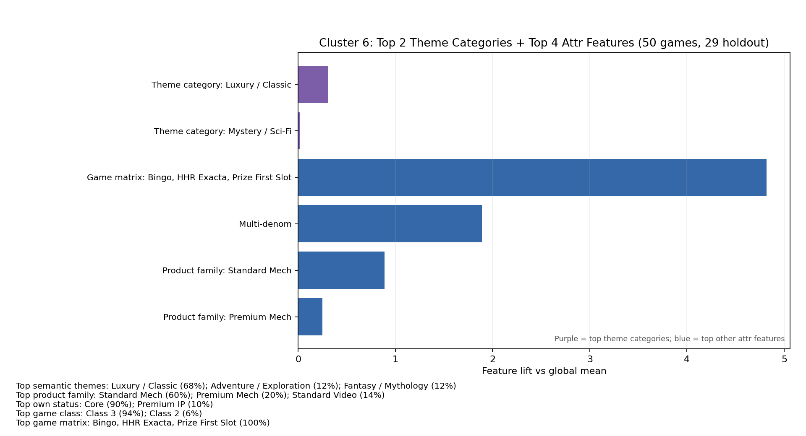
Cluster 6:
Historical examples: 8X Wild Dragon; Black Diamond Deluxe Signature; Blazin Grand Signature; Blessings of the Moon; Cash Machine Signature; Crystal Star Deluxe Signature; Double Black Diamond Signature; Double Crystal Star Deluxe; Evel Knievel Legend LAP; Gifts of the Sun Holdout example: Black Diamond Super Spin

Slide 15
Next steps
Training the forecasting model.
Incremental improvement of the pipeline.
Enriching game attribute matrix.

Slide 16
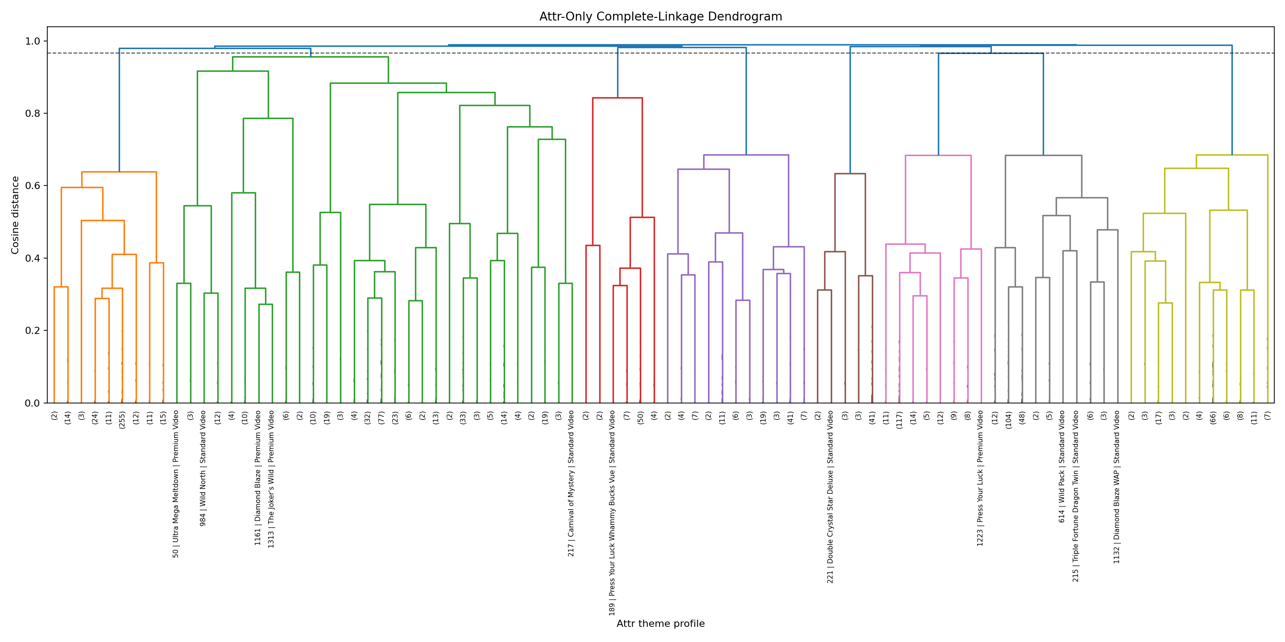
Appendix

